Slide 1
Capstone Project
Western Countries Financial Data

Slide 2
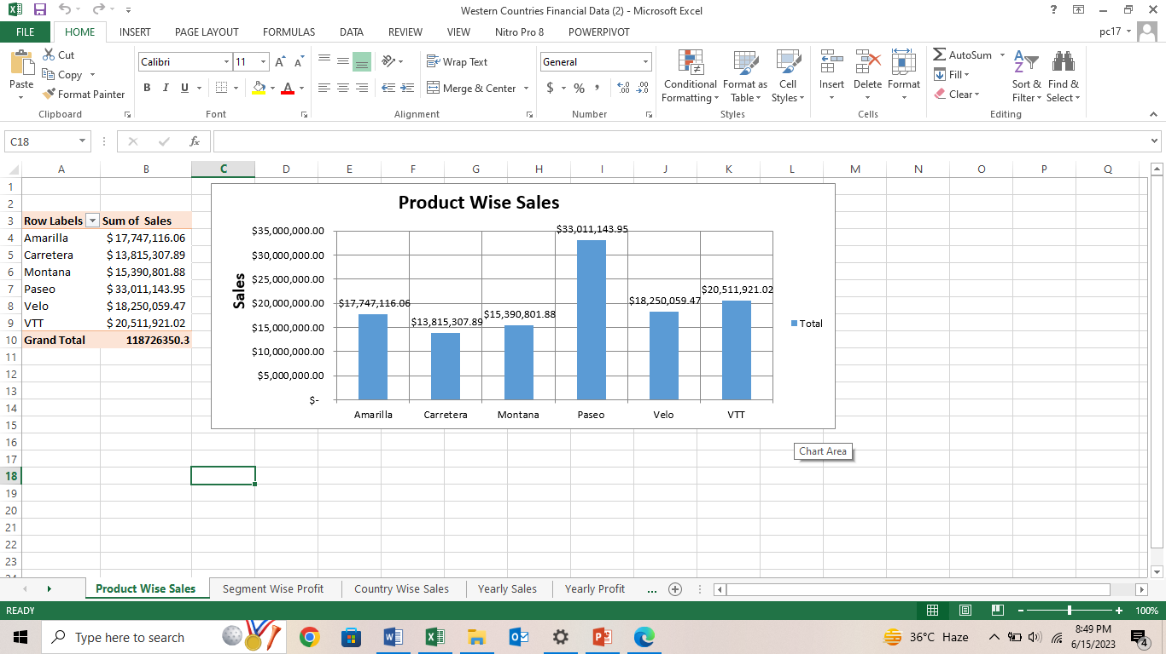
Q2. Perform Data cleaning if required and then do Statistical Analysis on data using statistical tools. Q 3 Perform Graphical Analysis on the Data using Excel and Derive insights from it. ➔ Product wise Sales

Slide 3
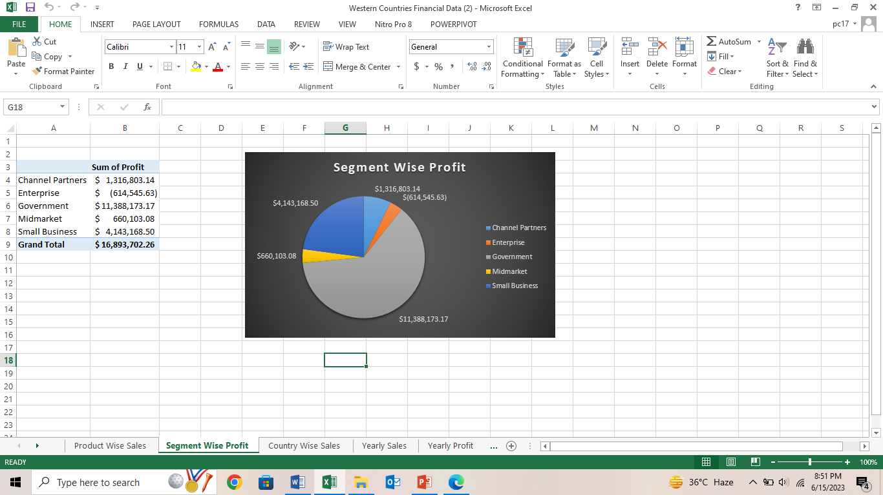
➔ Segment wise Profit

Slide 4
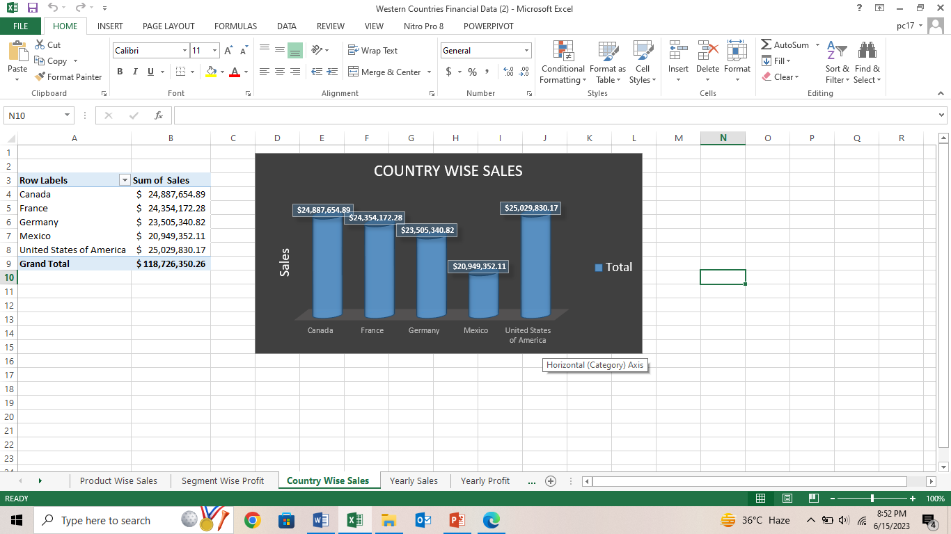
➔ Country Wise Sales

Slide 5
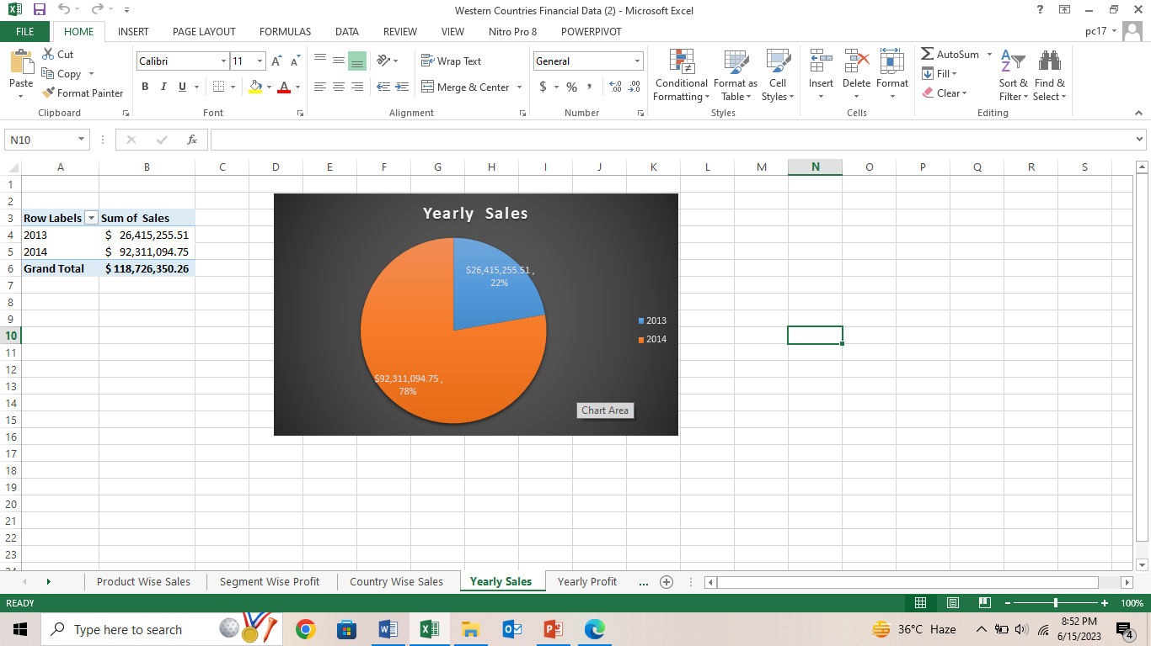
➔Yearly Sales

Slide 6
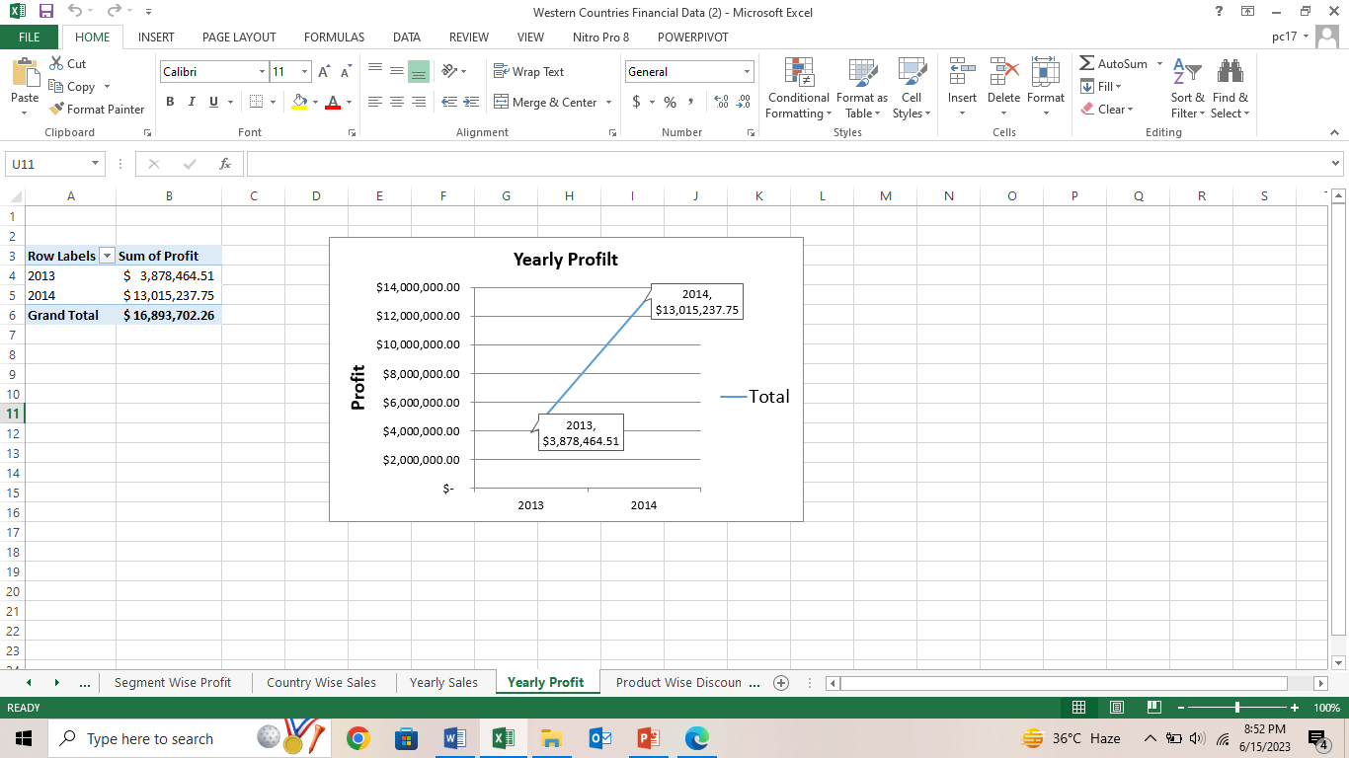
➔ Yearly profit

Slide 7
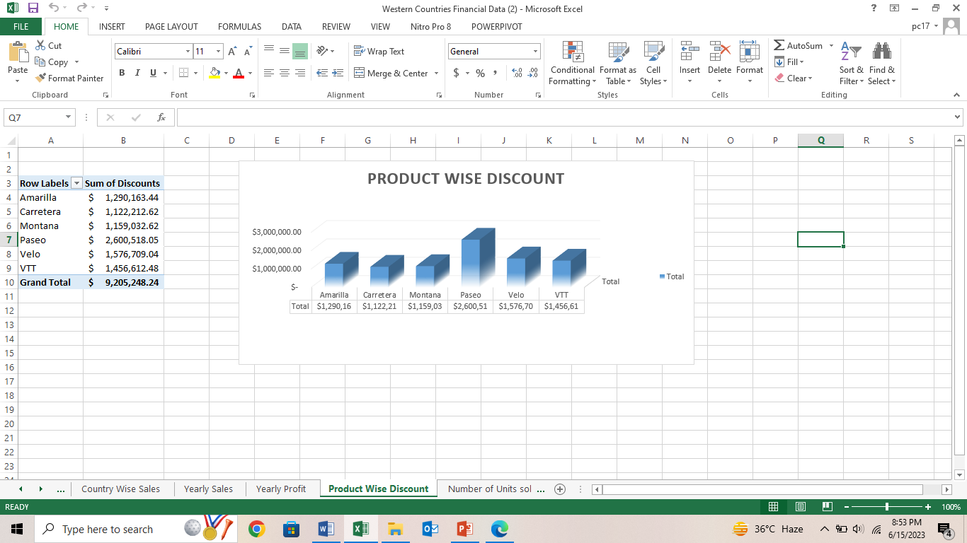
➔ Product wise discount

Slide 8
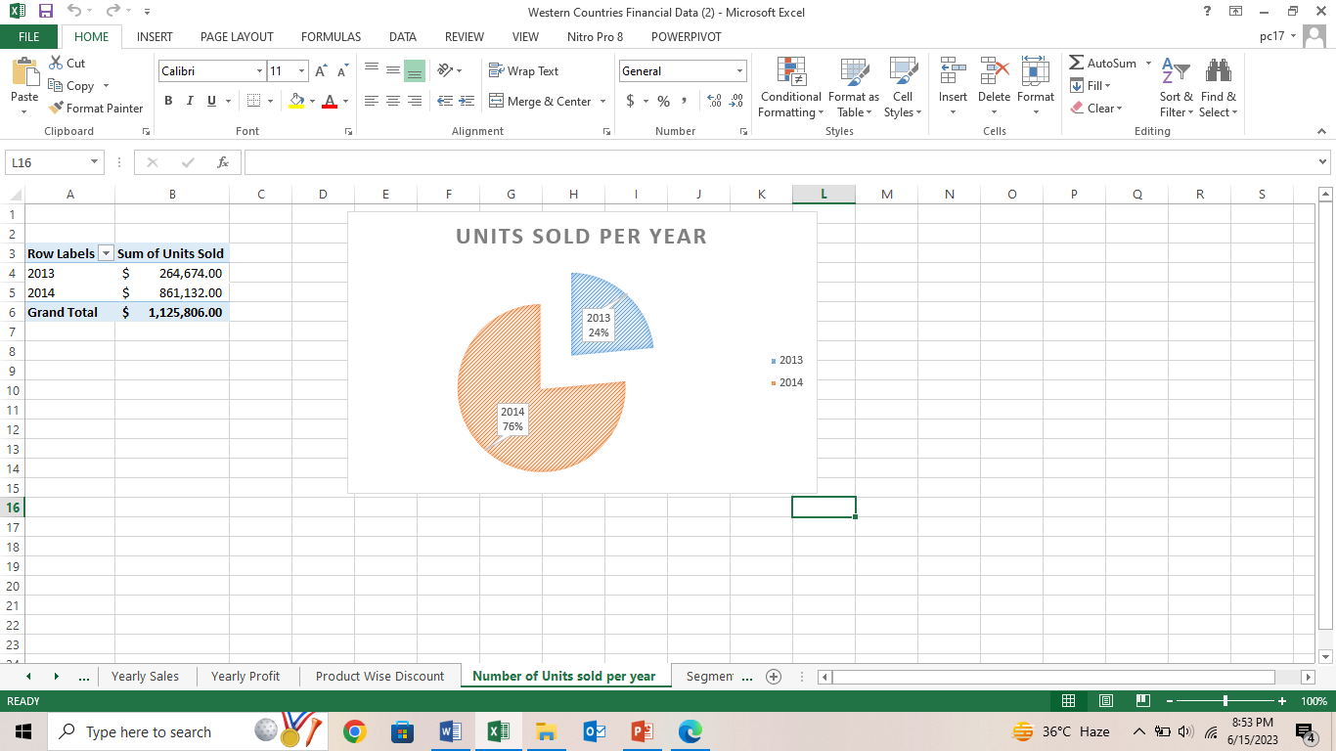
➔ No. of units sold year over year

Slide 9
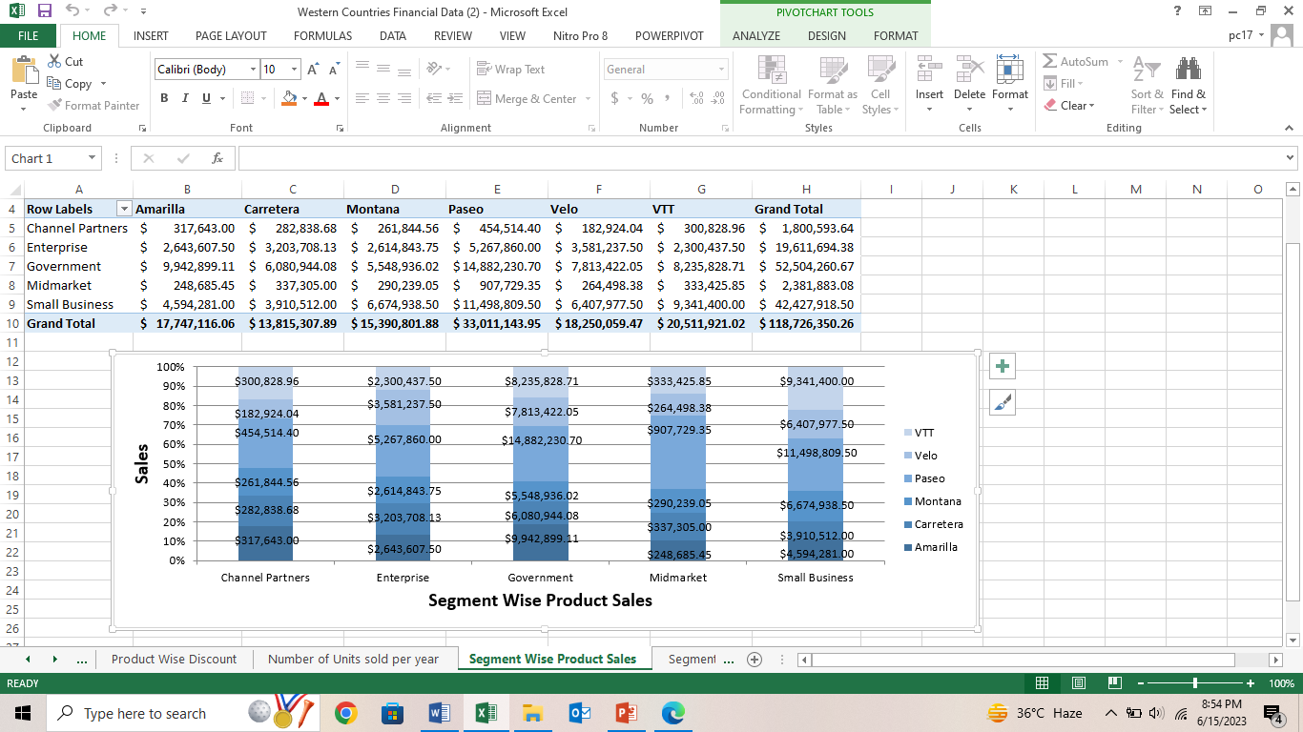
➔ Segment wise Product Sales

Slide 10
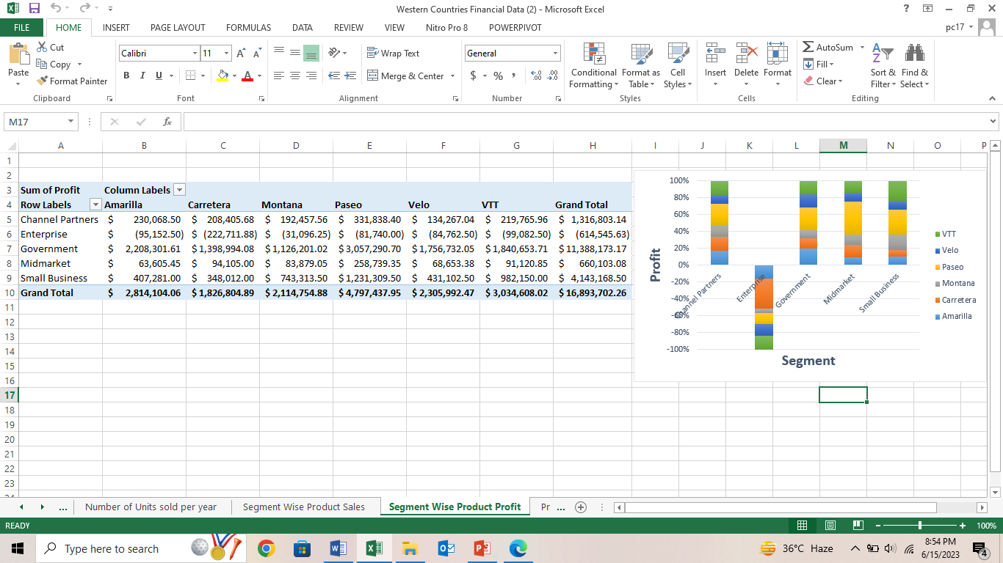
➔ Segment wise product wise profit

Slide 11
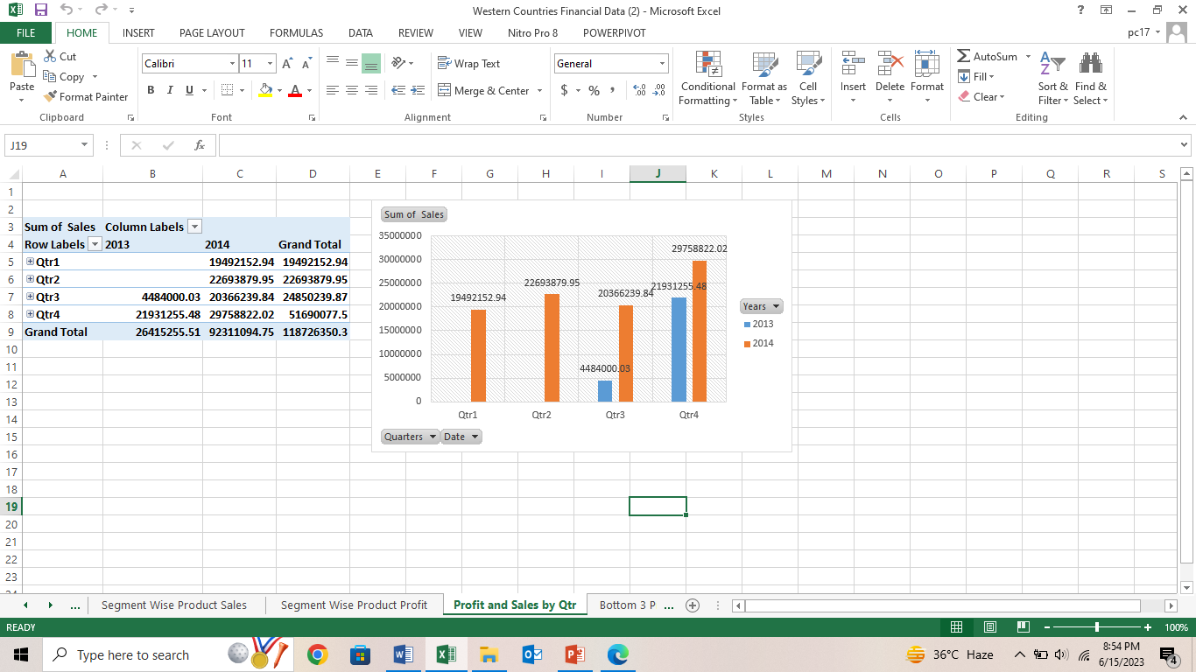
➔ Profit and sales by Qtr

Slide 12
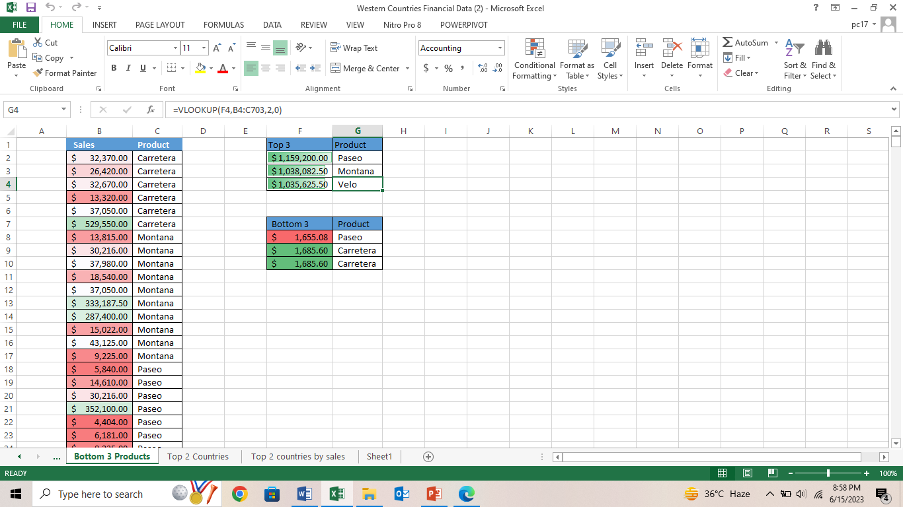
➔ Bottom 3 products

Slide 13
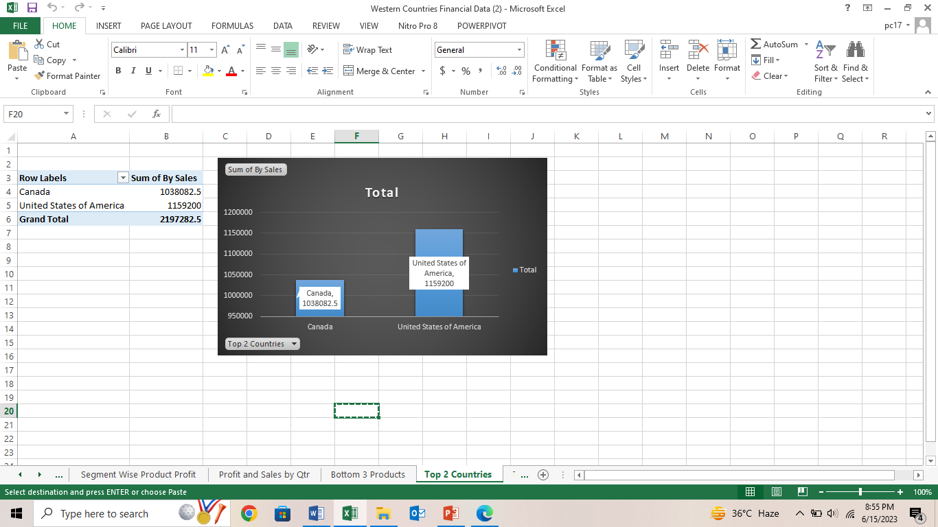
➔ Top 2 countries

Slide 14
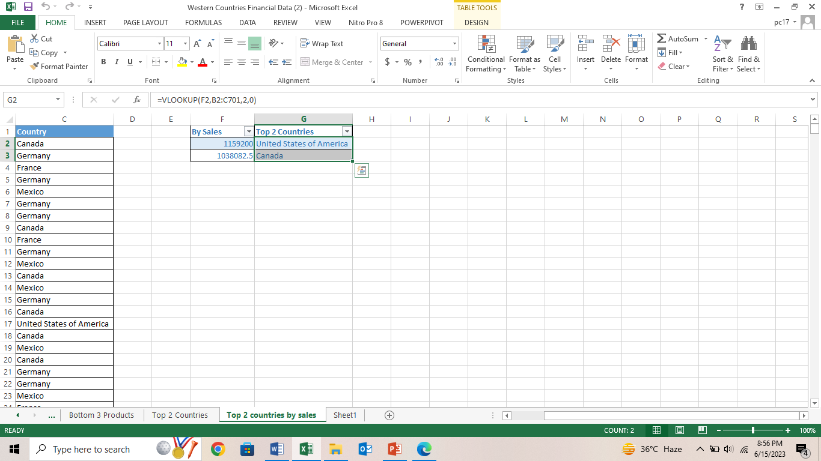
➔ Top 2 countries by sales

Slide 15
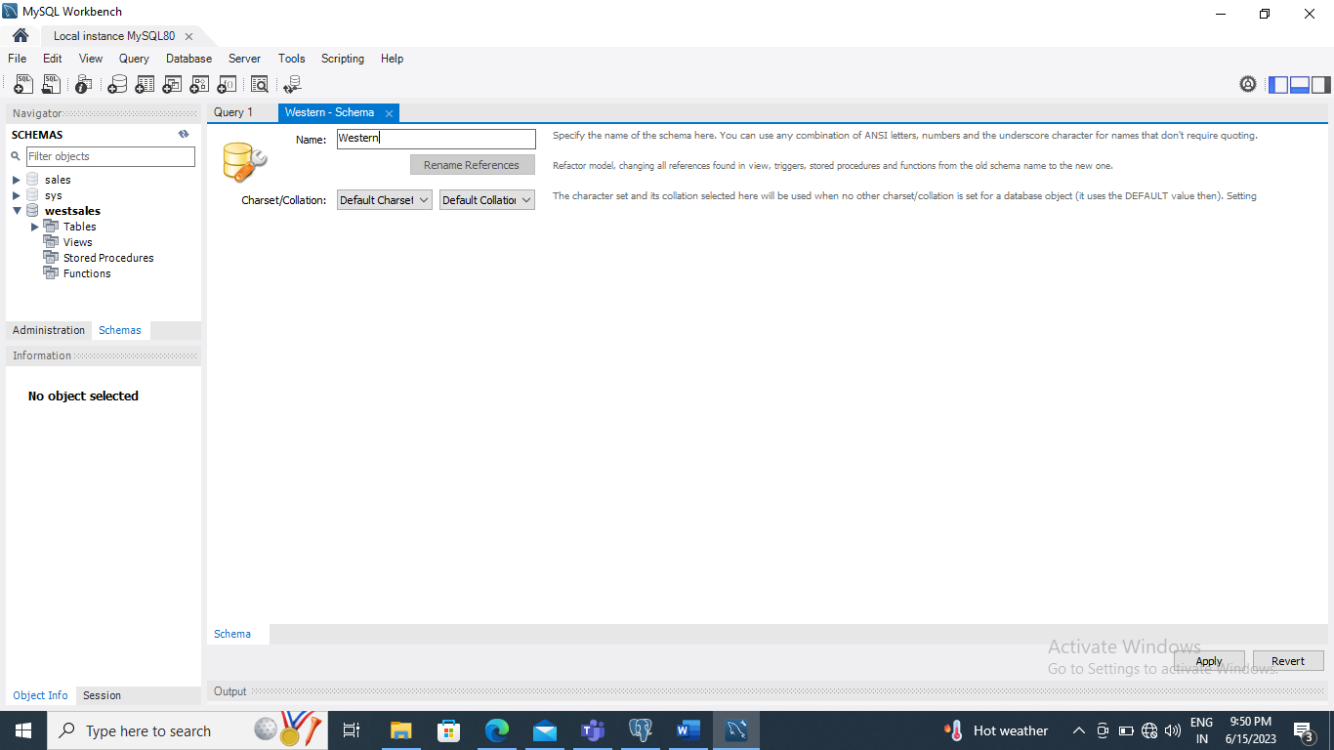
Q 4 Insert the given data into the SQL server by making a Database and defining the required parameters for the construction of Database and Database tables sol

Slide 16
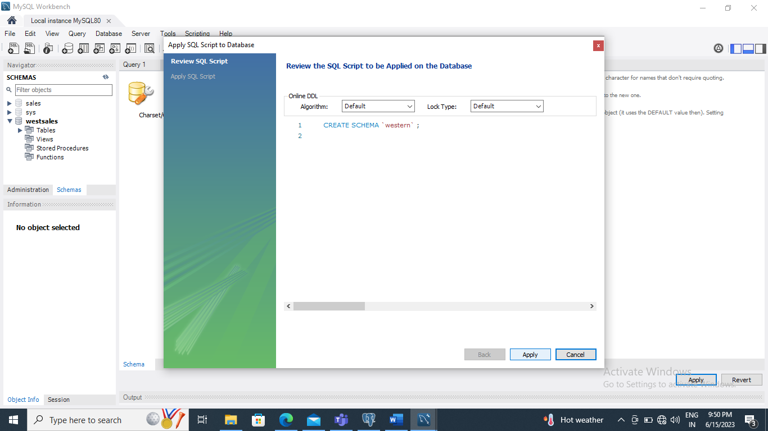

Slide 17
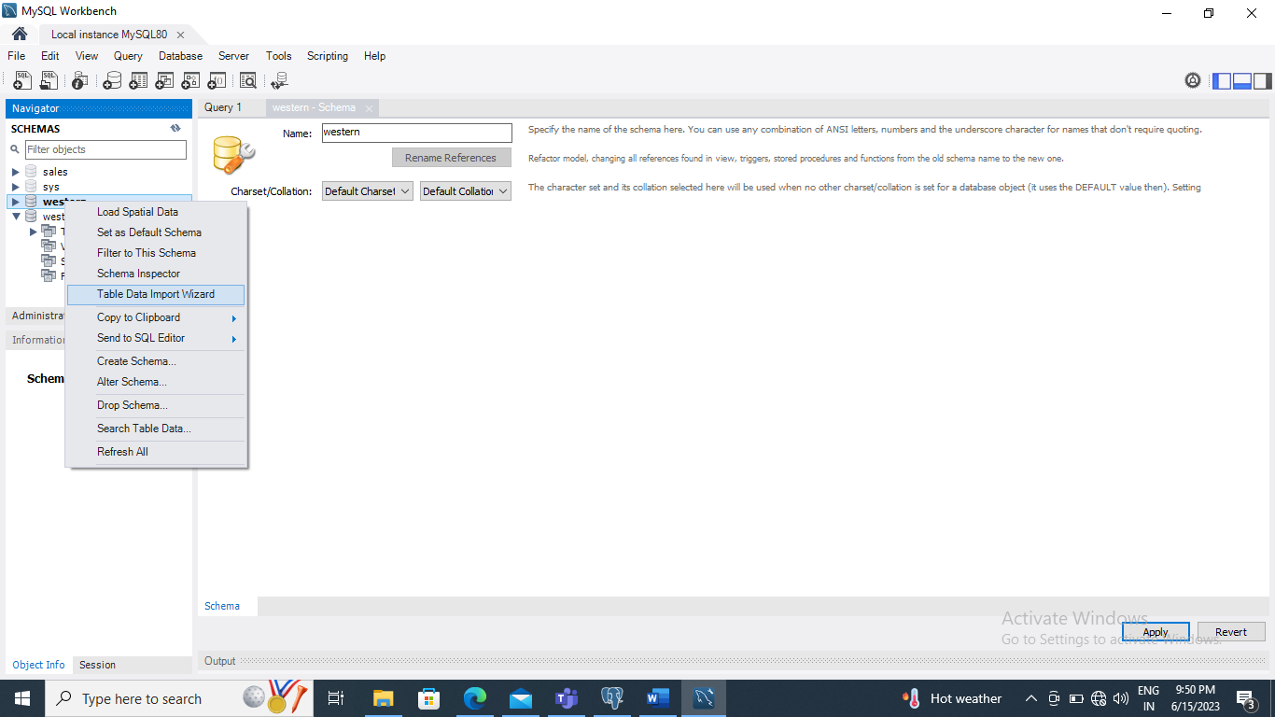

Slide 18
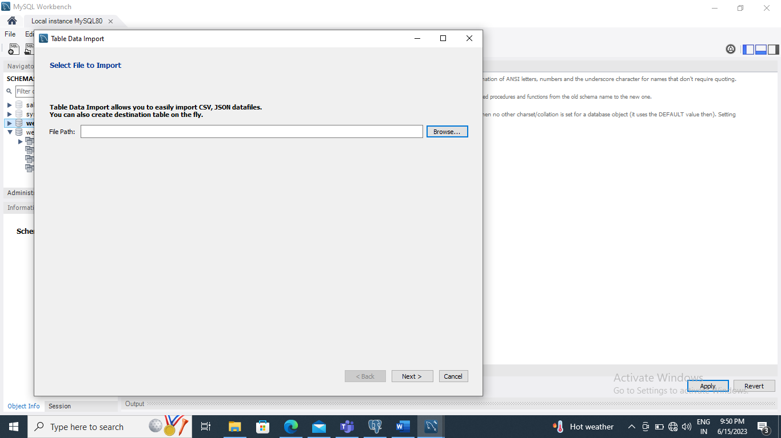

Slide 19
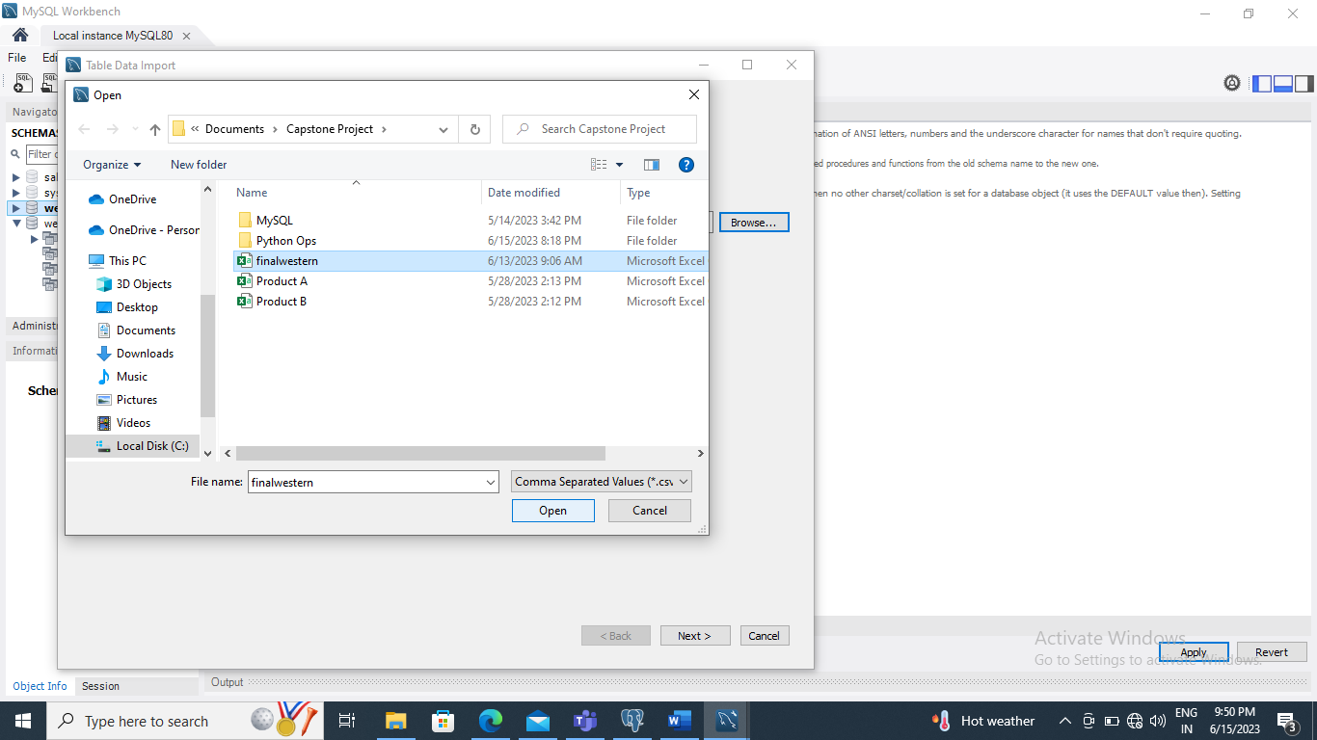

Slide 20
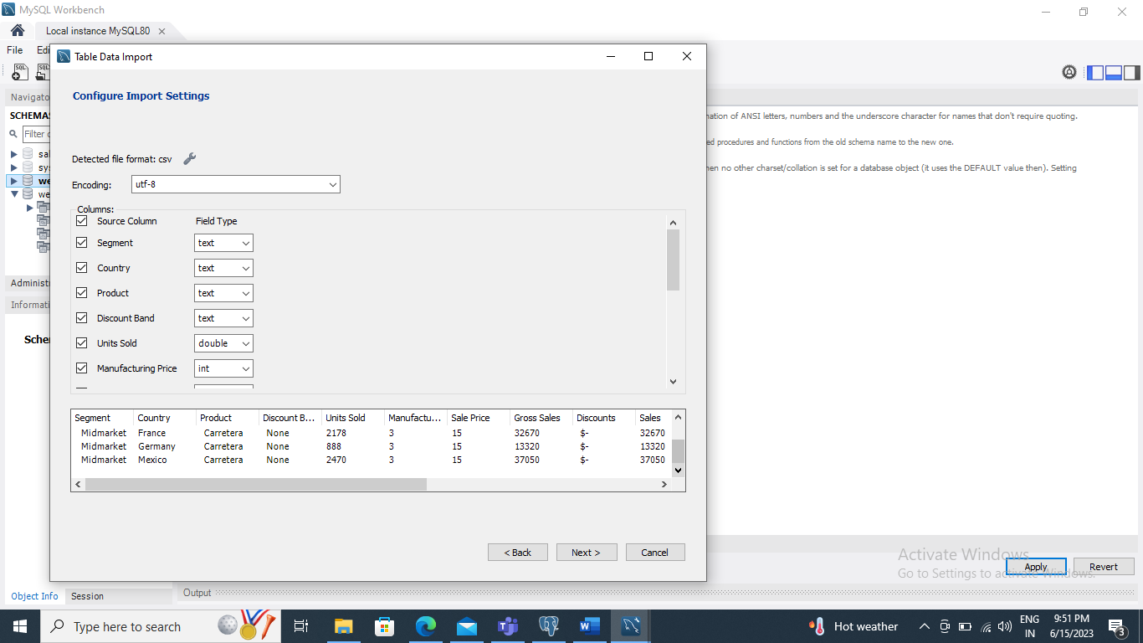

Slide 21
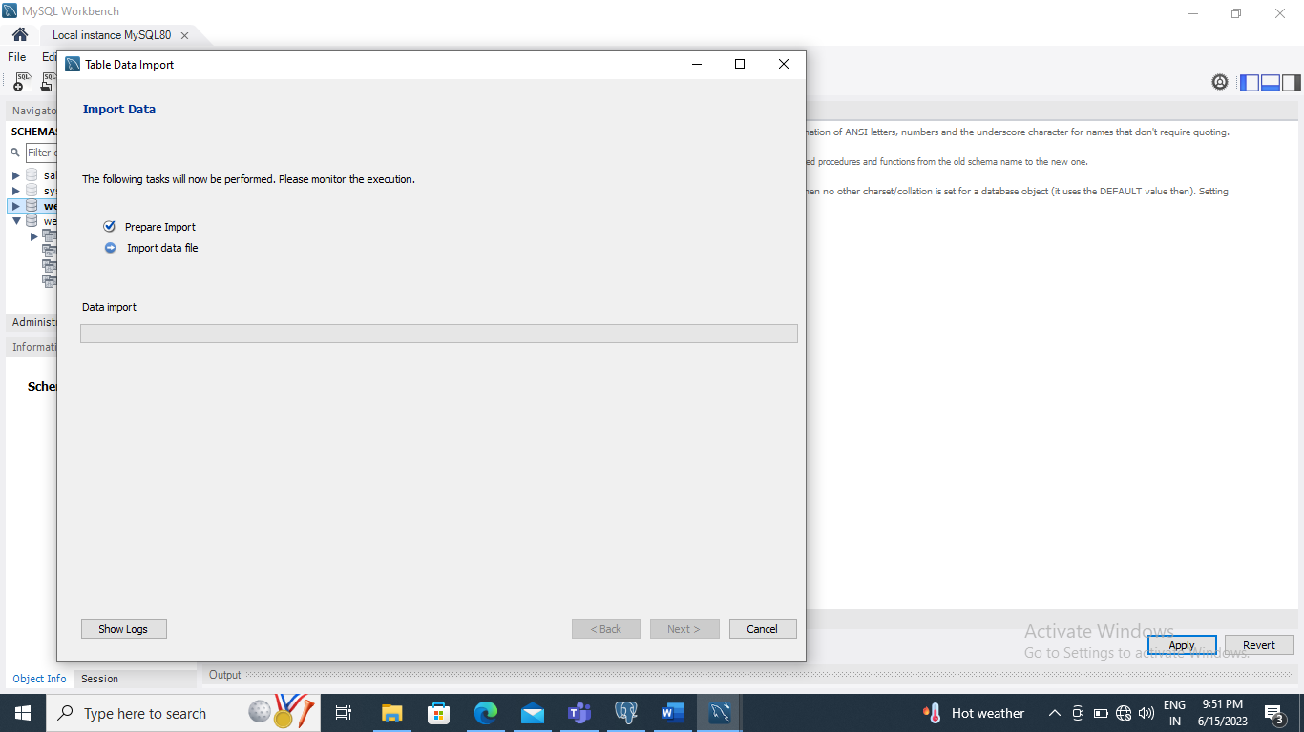

Slide 22
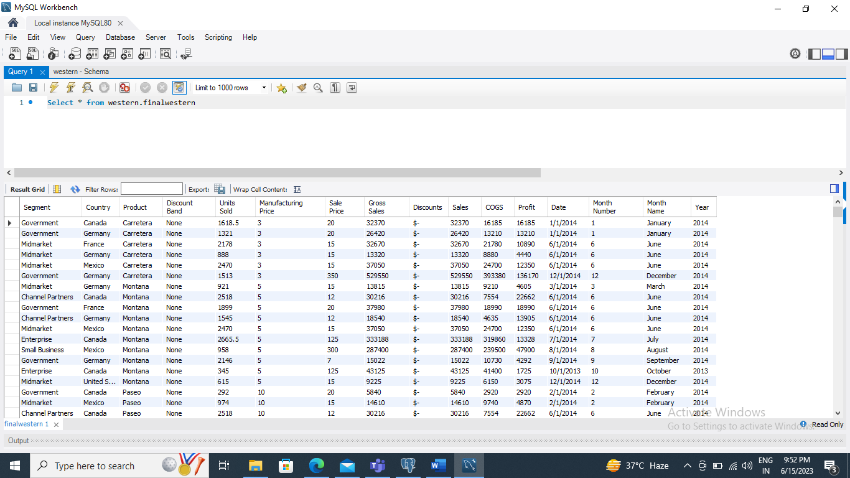

Slide 23
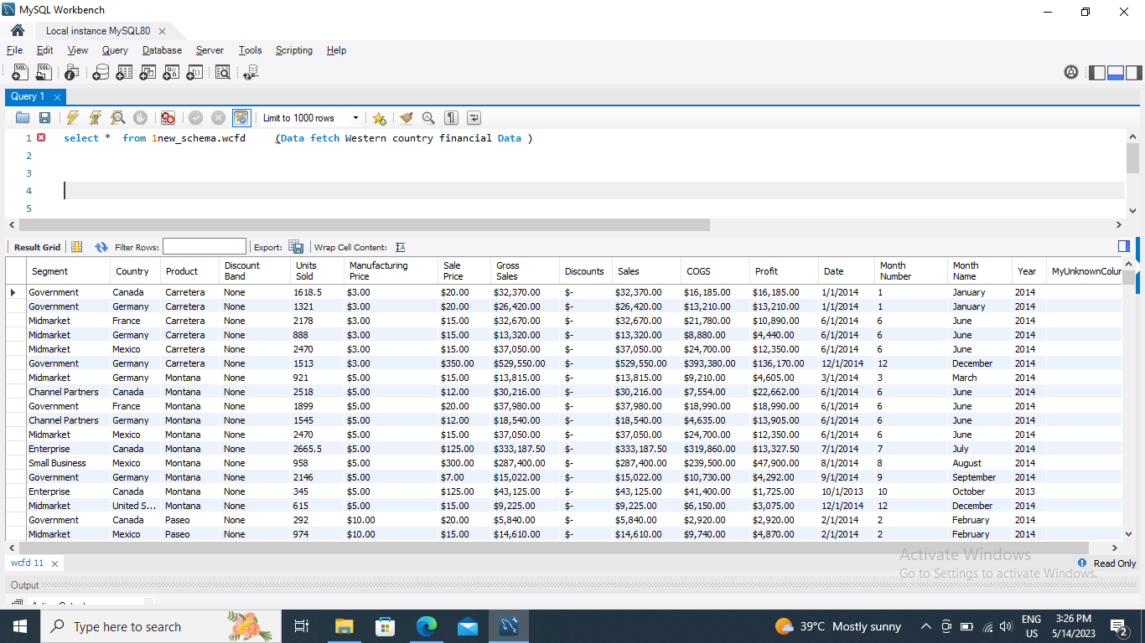
Q 5. Verify if the data is properly imported into the SQL database(Try running few Queries)

Slide 24
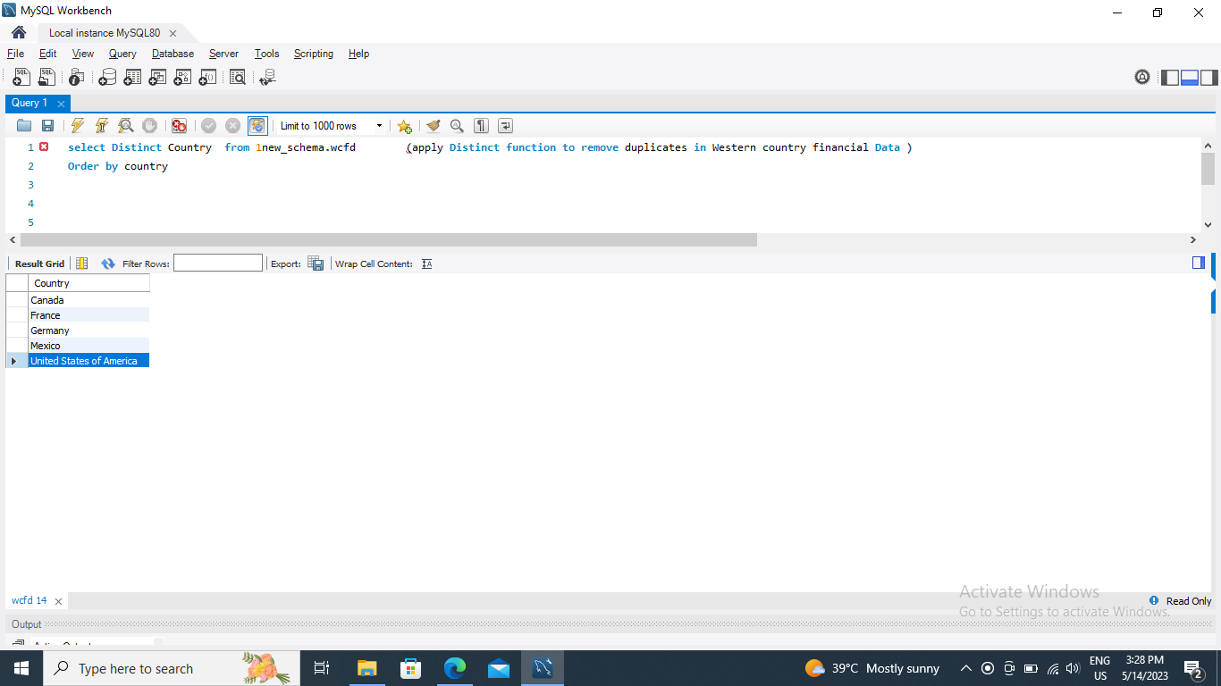

Slide 25
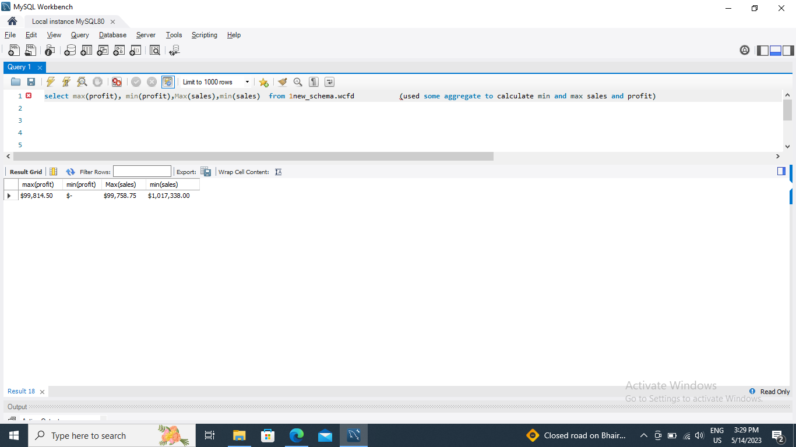

Slide 26
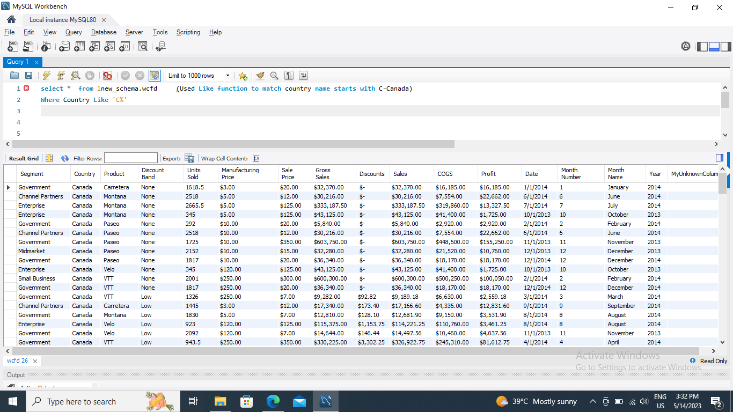

Slide 27
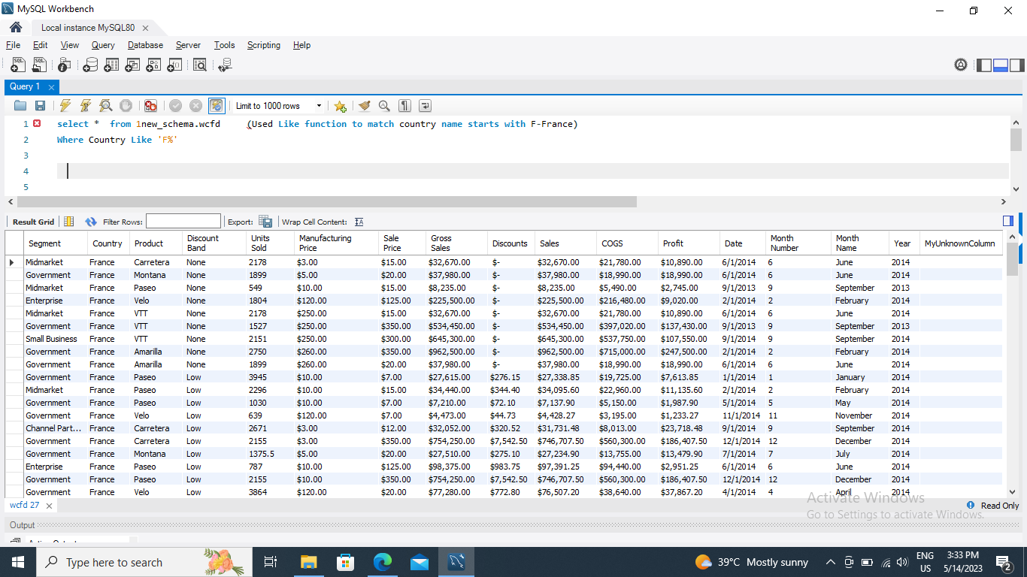

Slide 28
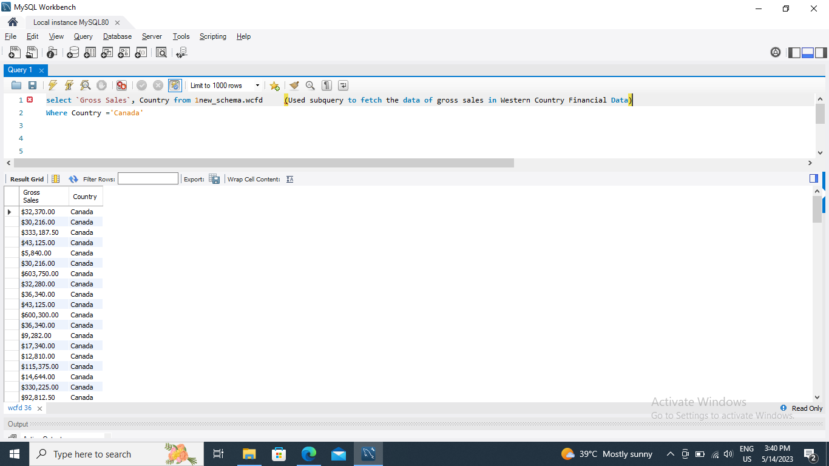

Slide 29
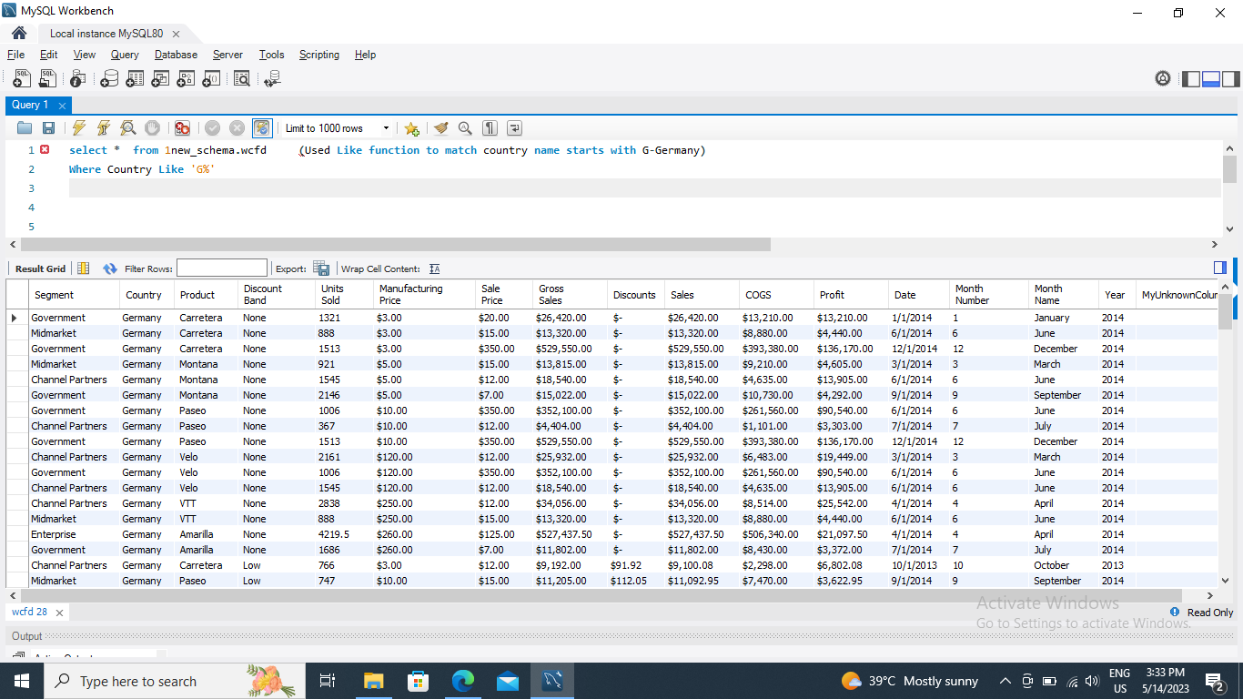

Slide 30


Slide 31
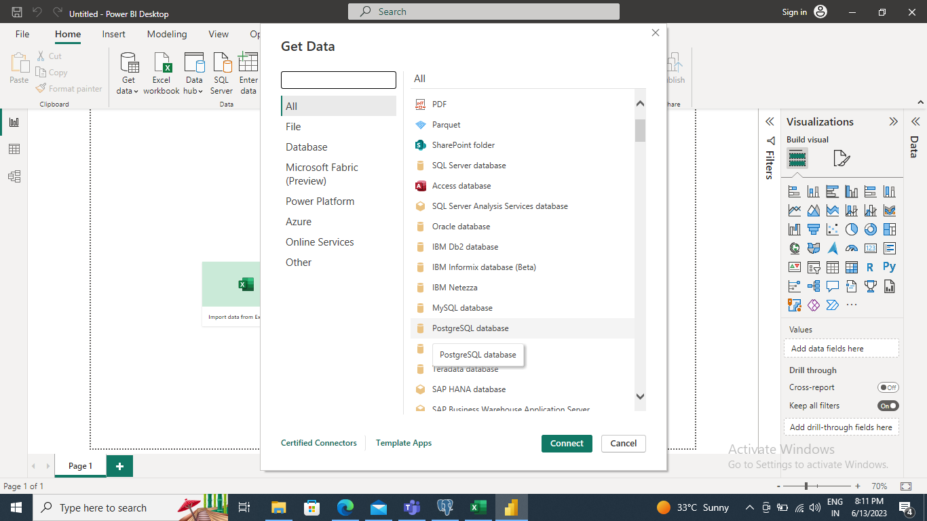
Q 6. Import the Data from the SQL Database into PowerBI ,verify if the data is properly imported or not.

Slide 32
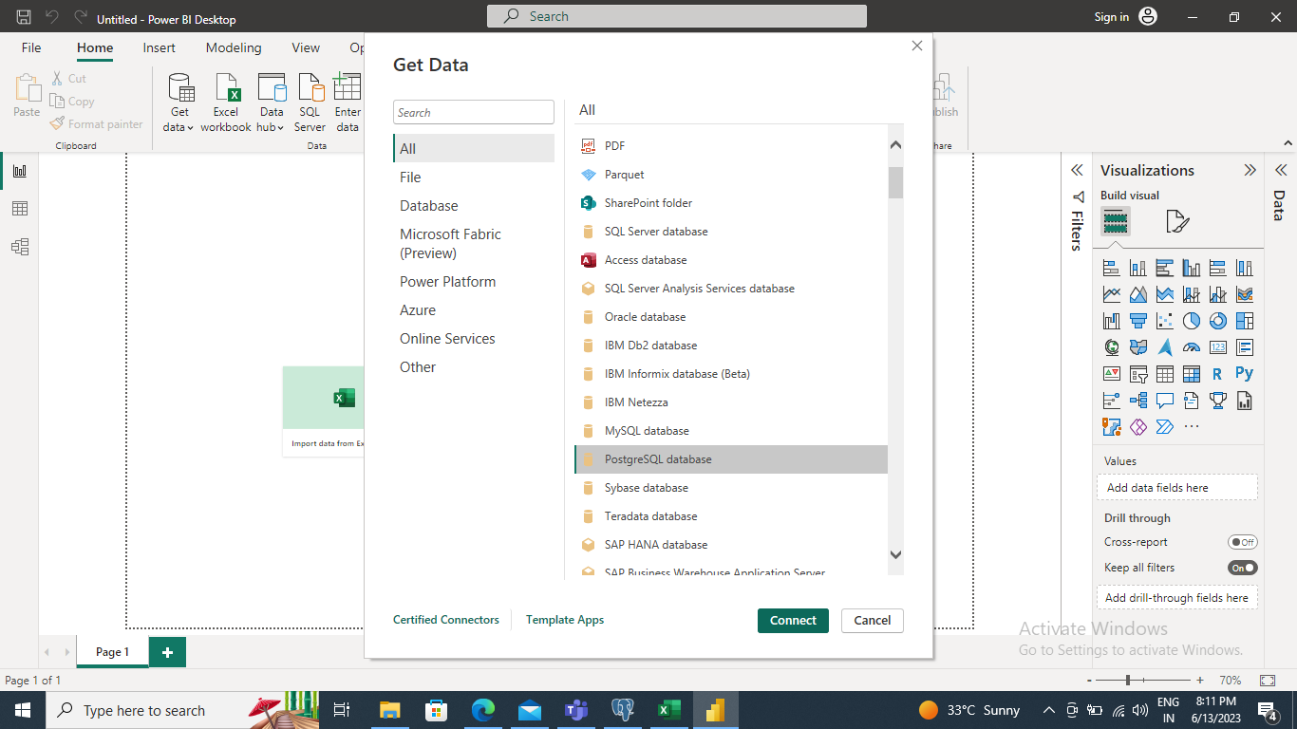

Slide 33
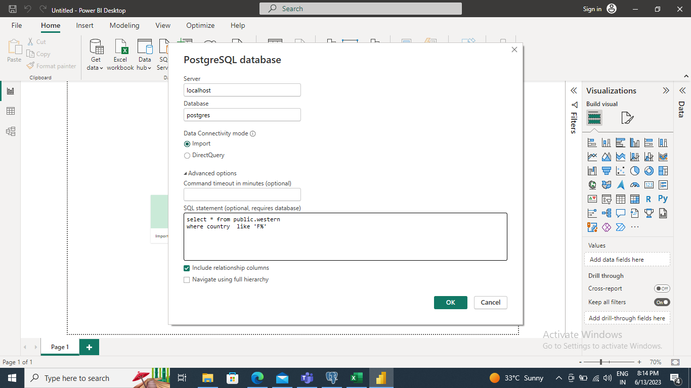

Slide 34
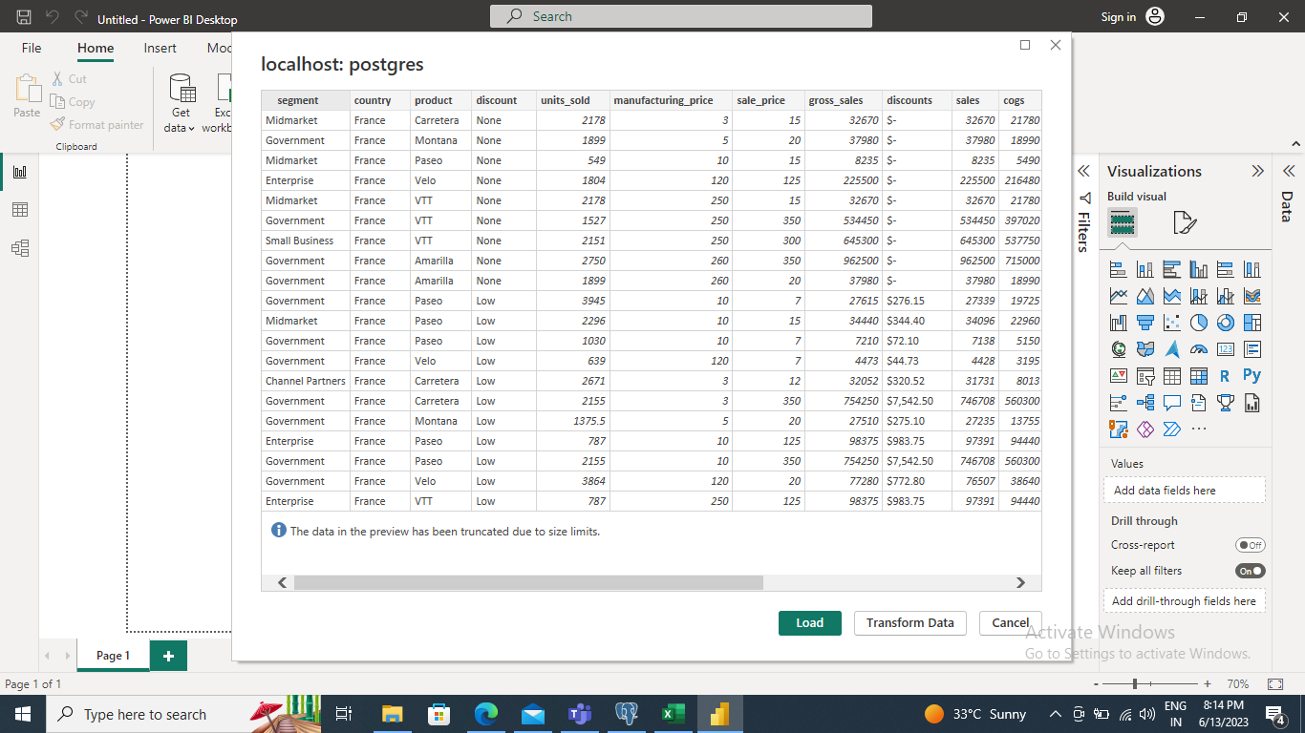

Slide 35
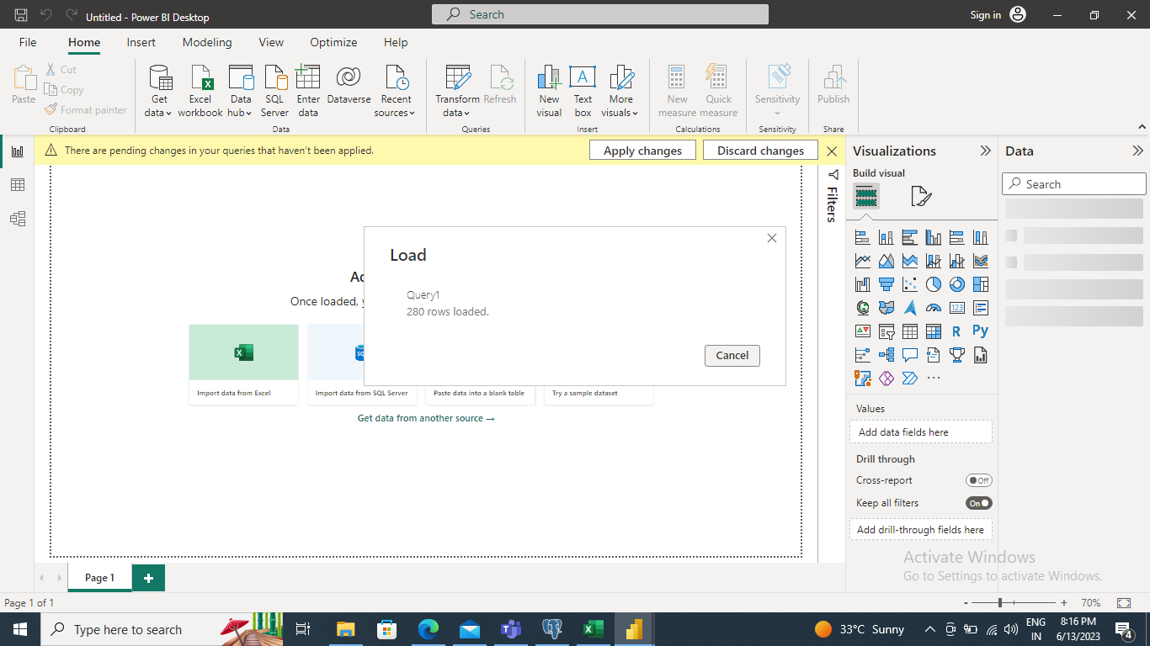

Slide 36
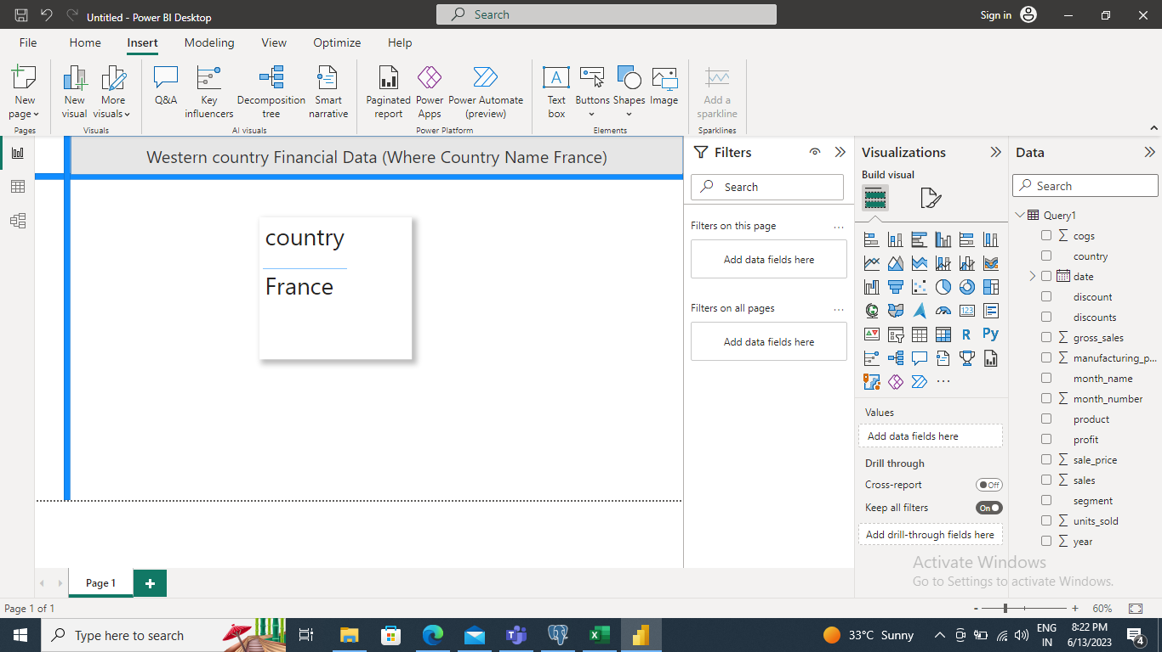

Slide 37
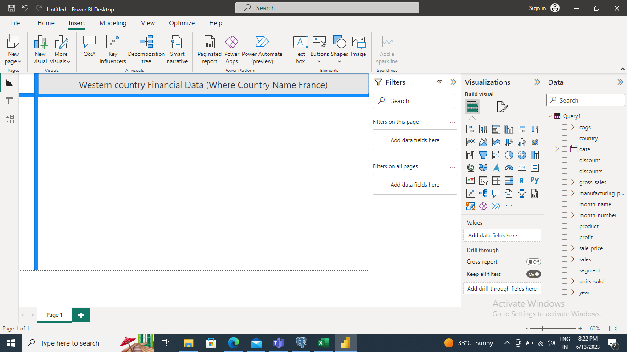

Slide 38
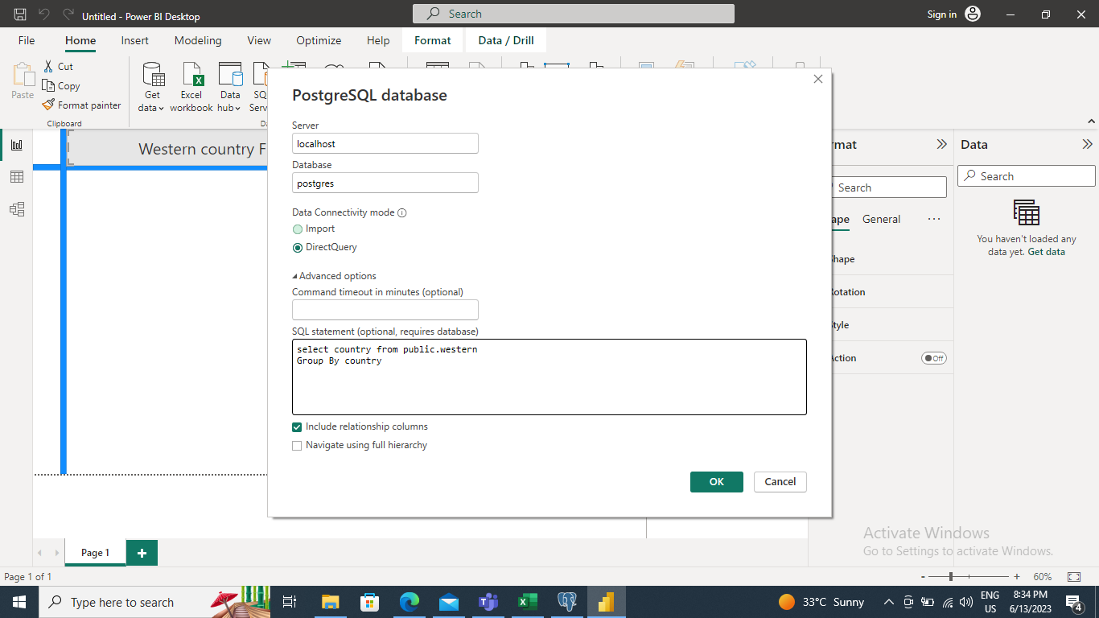

Slide 39
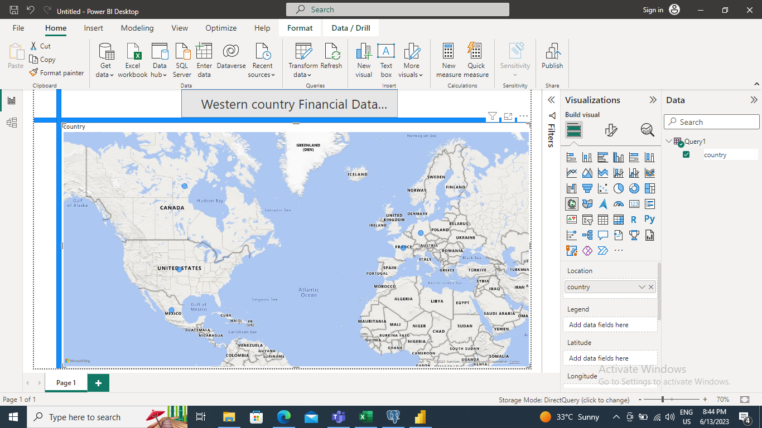

Slide 40
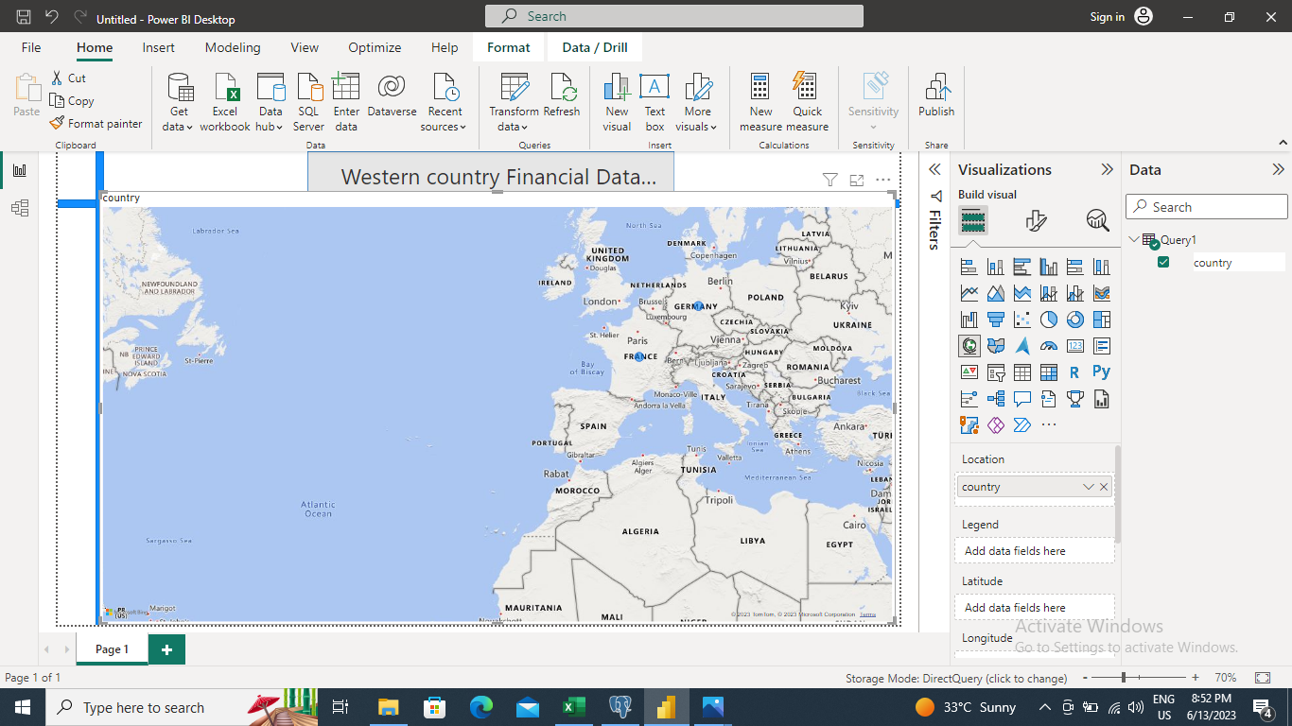

Slide 41
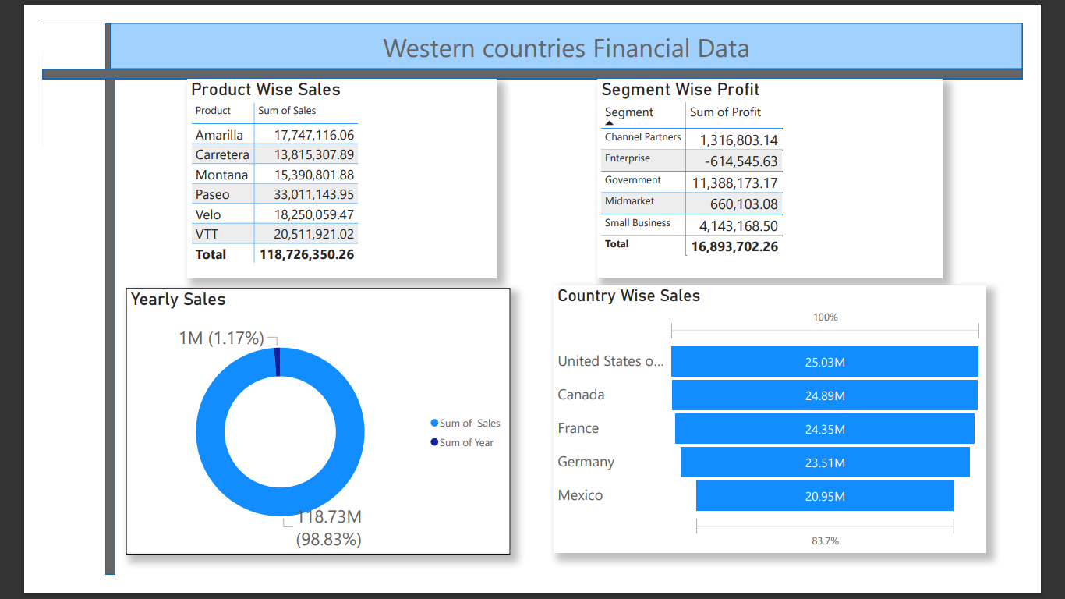
Q 8. Make a Detailed Interactive Dashboard by using visualization tools such as PowerBI and Answer the following questions :

Slide 42
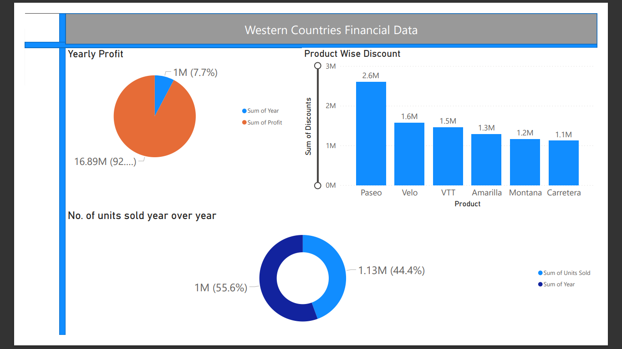

Slide 43
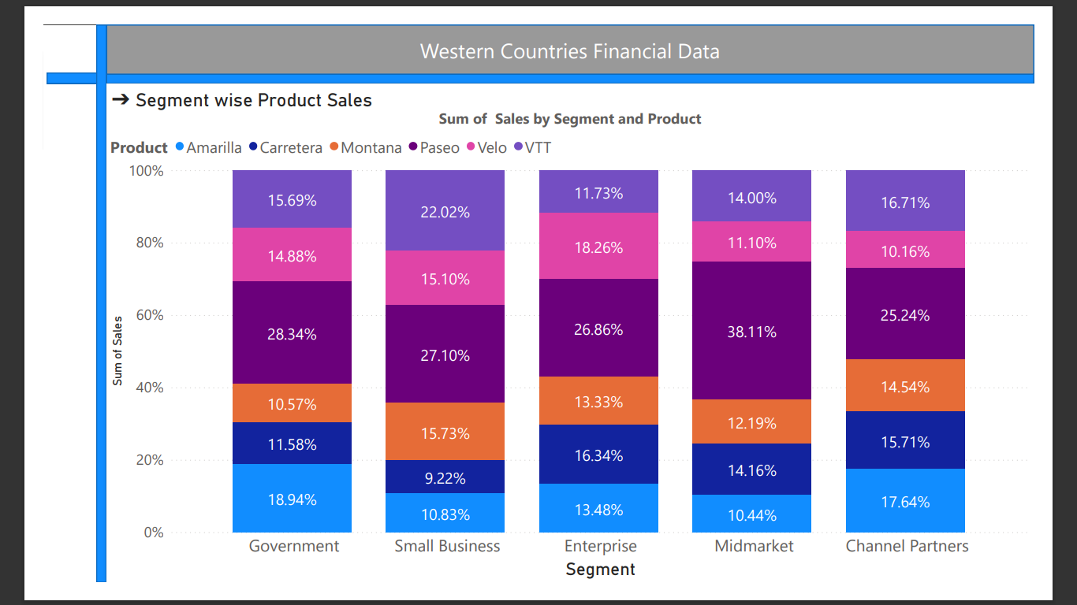

Slide 44
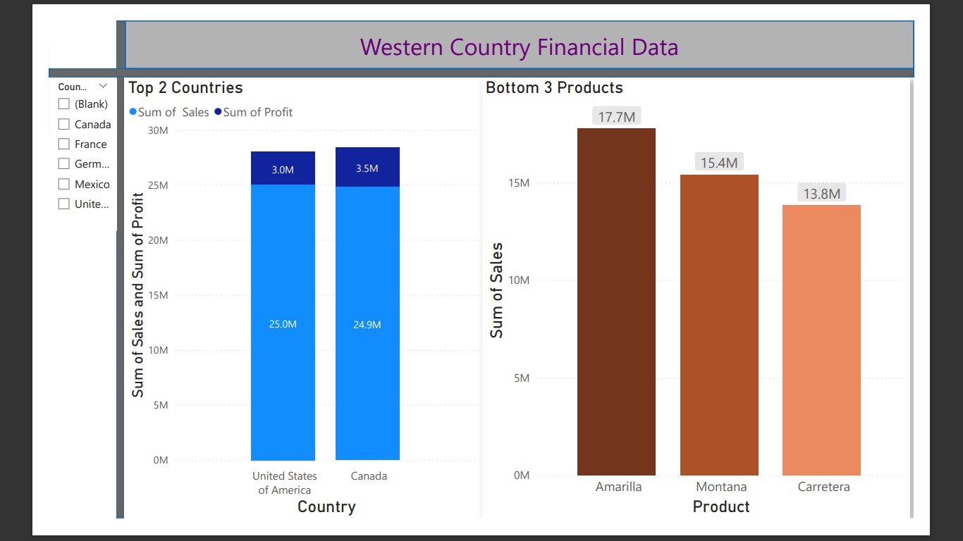

Slide 45
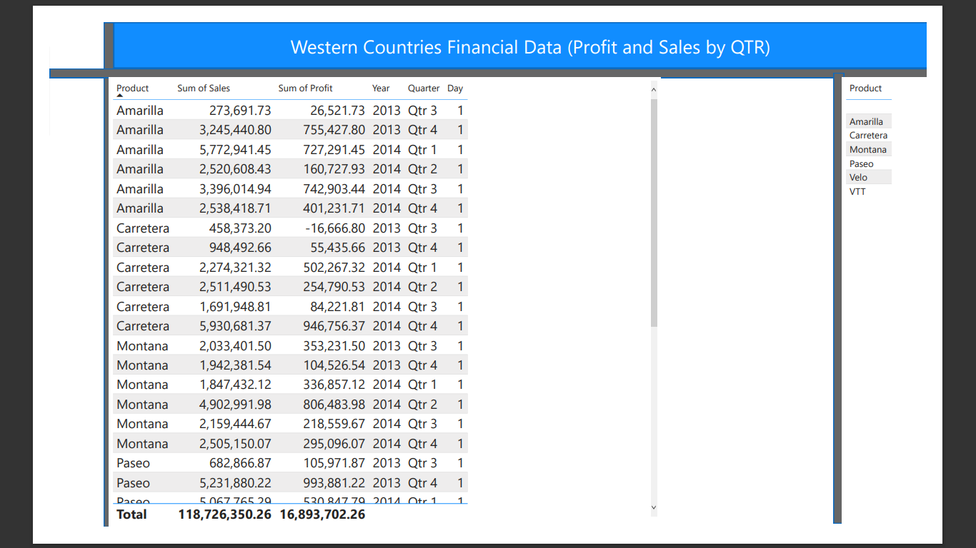

Slide 46
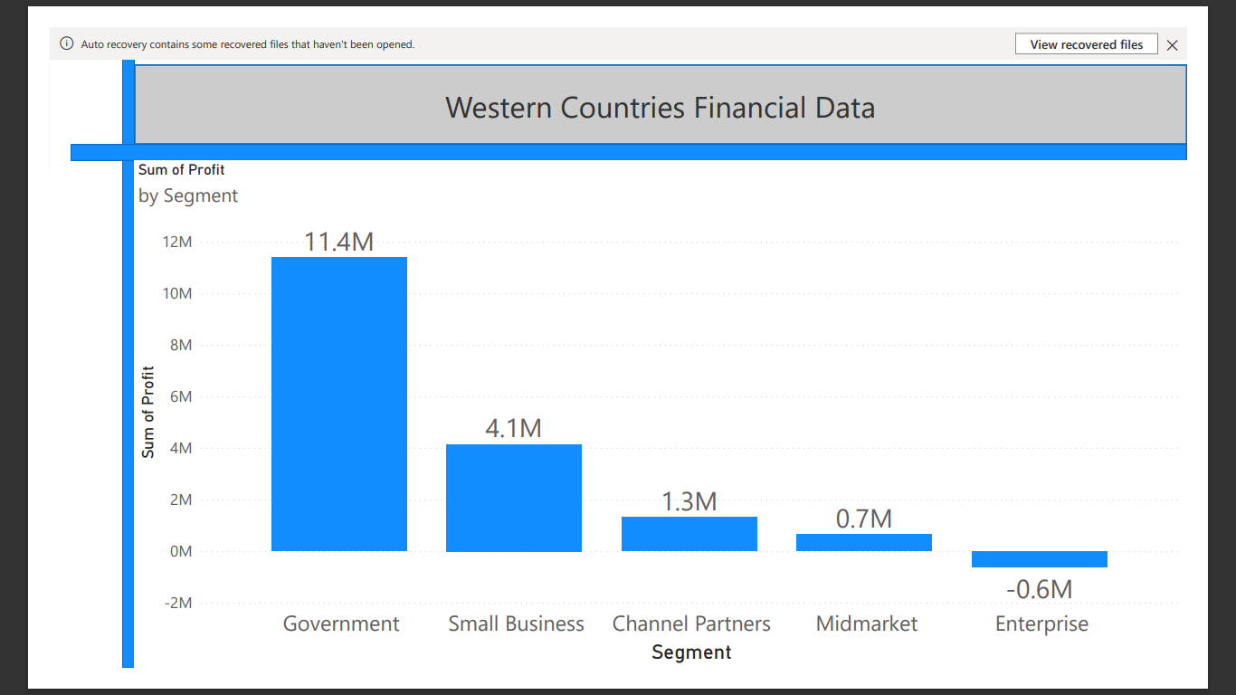

Slide 47
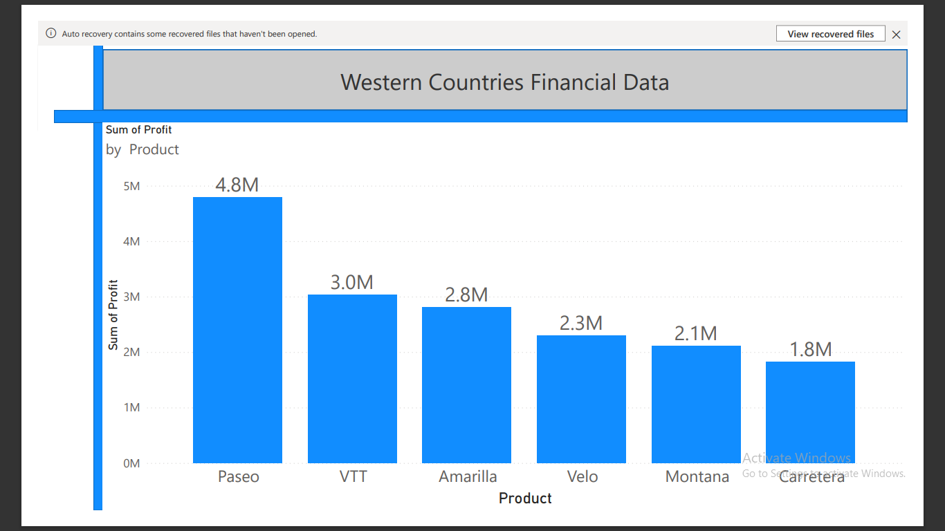

Slide 48
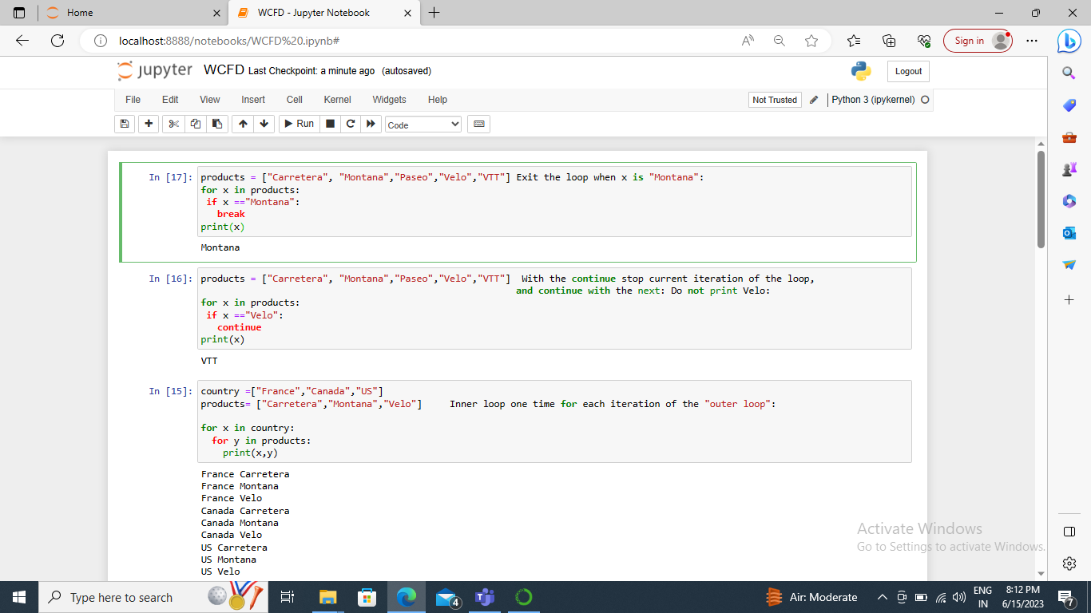
Additional Operation using Python

Slide 49
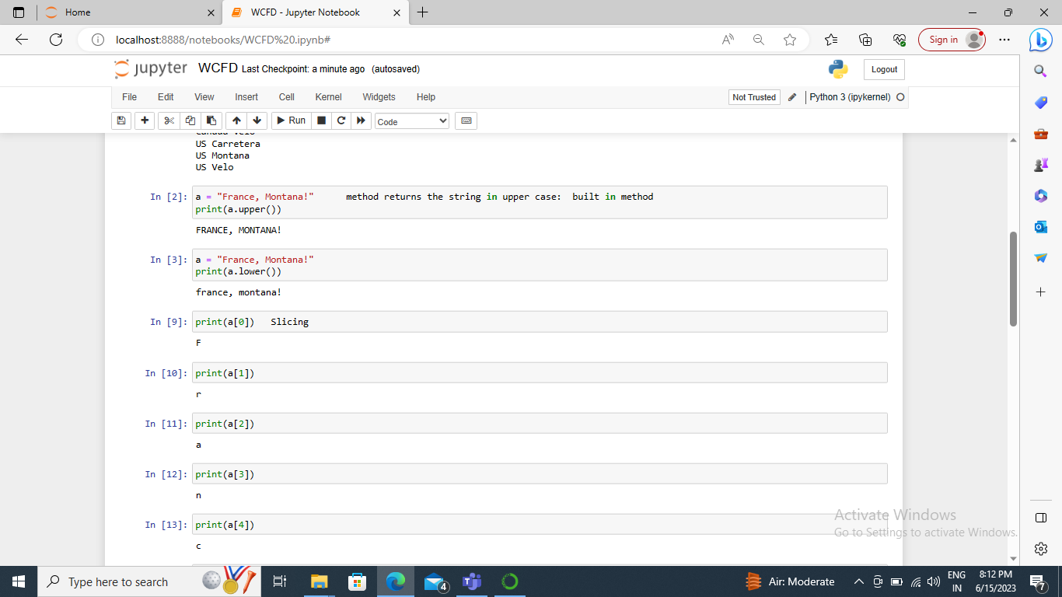

Slide 50
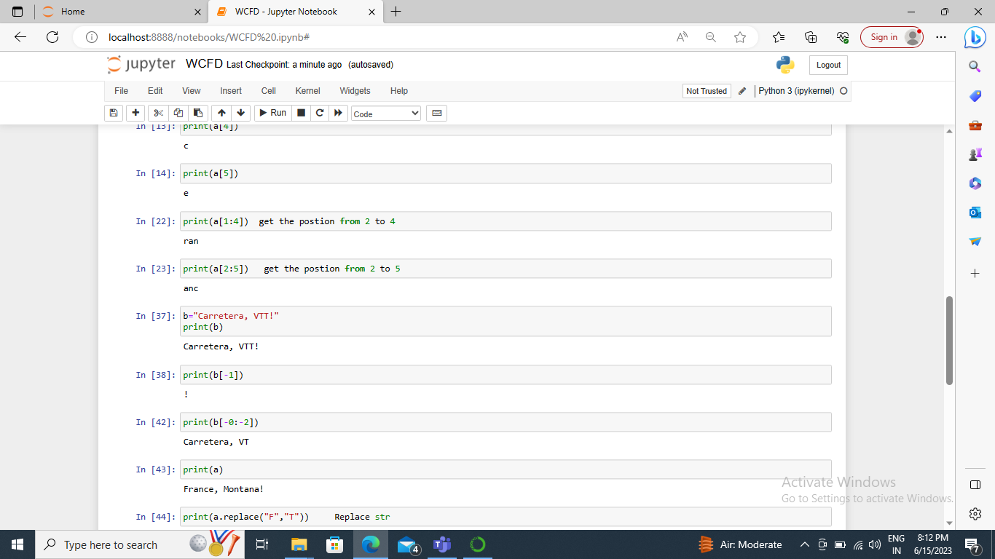

Slide 51
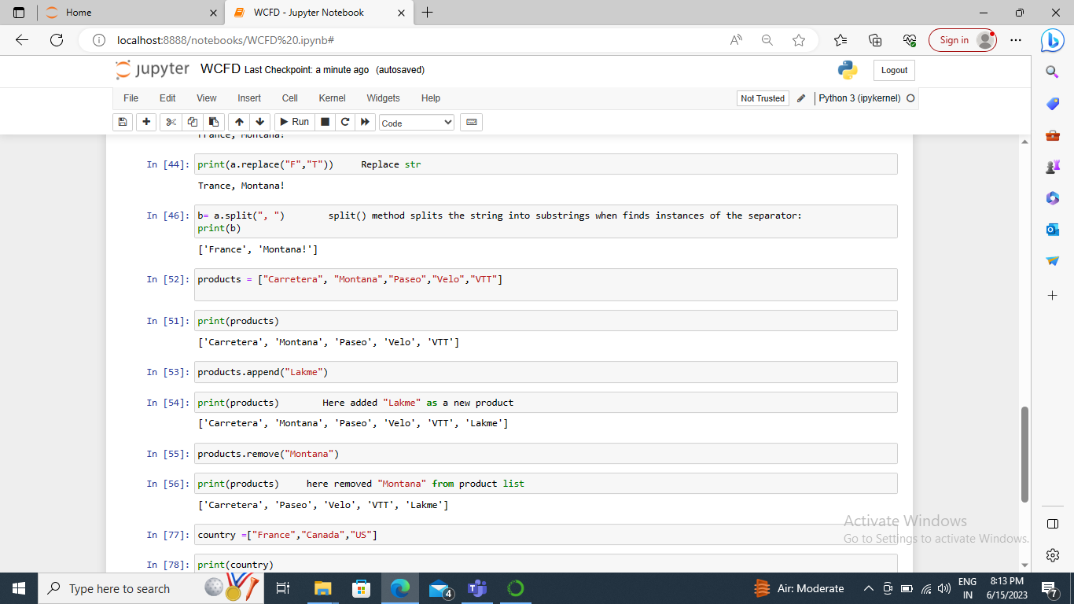

Slide 52
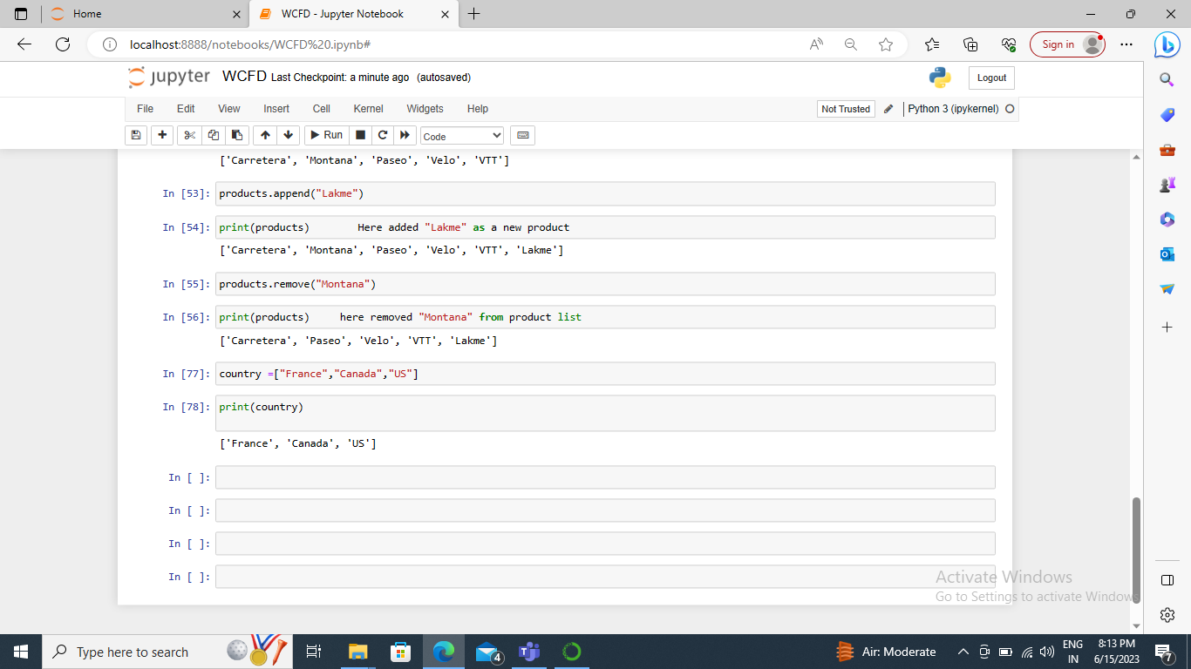

Slide 53
Q 1. Explore the Data using Excel .understand the data and prepare a short summary about the dataset solution Short Summary
Data cleaning points (Excel- Western Countries Financial Data)
1. In Year Column, i had to ignored some errrors naming cells 2014.
2. There is about 700 columns and 701 Rows using =Rows() and =Count() formula to count all of these.
3. In this step, data is cleaned by using table format quicky format a range of cells and convert it into a table by choosing a pre-defined Table style.
4. While cleaning the data, used all borders to keep organize the data insights and align test to the left.
5. Data modification is to be set up by update some common column in SQL server to perform joints table Meanwhile, I add two common columns naming Product ID on given western countries financial dataset.
6. Imported Western countries financial report to perform graphs from SQL server to Power BI dekstop.
7. Implemented measures in PowerBI in order to highlight Top 2 countries from sales point of view and bottom three products.
8.Furthermore, created schema in MySQL workbench to fetch given data and made database called western and fetched while using data table import wizard option in MySQL Workbench where I performed some queries respectively.
9. Additionally , performed some python functions in western financial data.

